Slide 1
Introduction to computerome and good practice
Baptiste avot – research assistant genomic epidemiology
bavja@food.dtu.dk (only if experiencing trouble using computerome)

Slide 2

PSA: We’re still missing some information from a fair share of you to access or login to computerome
Even if you already have a Computerome account you still need to be added to the course group on there so please send me your already existing username (bavja@food.dtu.dk)

Slide 3

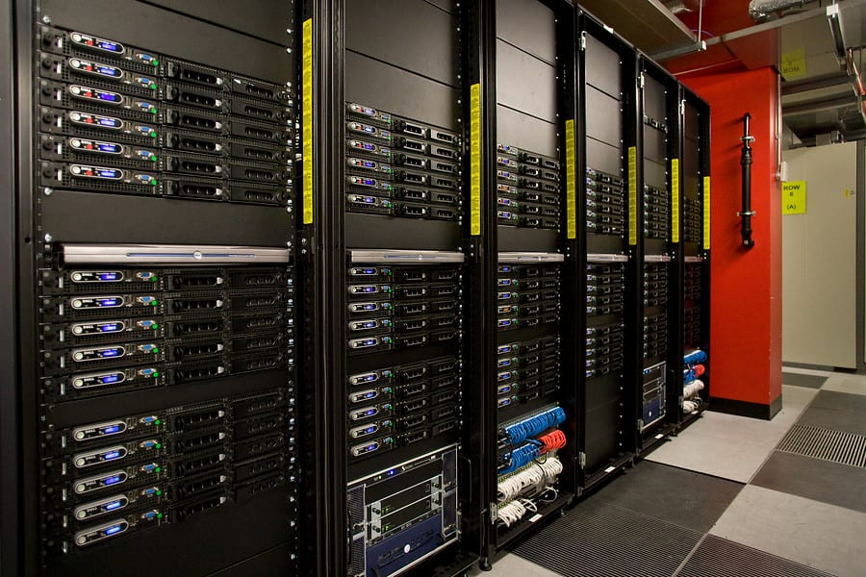
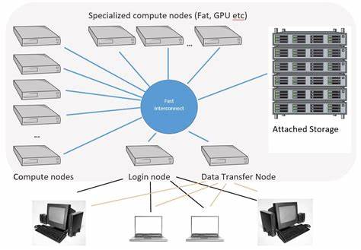
What is computerome (for those who don’t know)
HPC (High Performance Computing) Cluster (collection of « nodes » or computers): one login node and dozens of computing nodes.
Works with Linux CentOS 7 distribution (minimum knowledge of bash required for this course)
Main rule: do not run heavy duty commands on login node (or risk getting told off by Computerome maintenance)
This Photo by Unknown Author is licensed under CC BY

Slide 4
Logging in
Computerome works under MFA (Multi Factor Authentification) which is why you were asked for a phone number
When logging in for the first time you need username, password and you should receive a text with temporary password
For windows users you will need MobaXterm (can be tricky) if not working switch to Putty (less convenient)
MAC OS users will just need to enter: ssh ssh.computerome.dk in their command line

Slide 5

Entrust Identity app
If you don’t want to rely on SMS everytime you login, you can setup an app to substitute mfa as explained here:
Two-factor authentication - Computerome 2.0 Wiki - Computerome

Slide 6
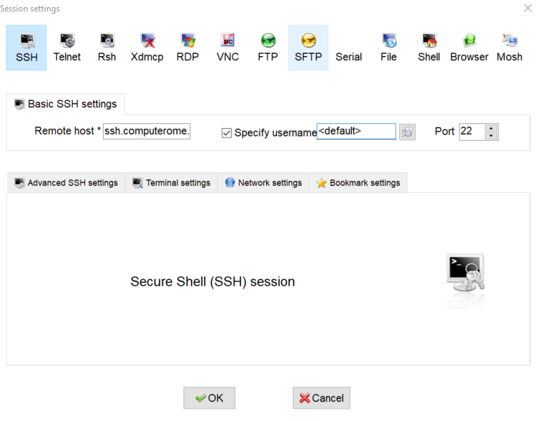
Mobaxterm for windows users

Slide 7
Overall structure (where to store and access files and tools and where to run your commands)
4 main directories you need to be aware of:
/home/people/$username/: your personal directory (10GB limit)
Most of the course content will be here:
/home/projects/course_2/tools : most of the tools that are not modules will be available here.
/home/projects/course_2/course/$week_x : course material for each week
/home/projects/course_2/groups/$group_x: shared repository for group work (will need to use chmod to give access to your fellow group members)
/home/projects/course_2/data : self explainatory
/home/projects/course_2/people/$username/: another personal directory!

Slide 8
How to submit jobs
Disclaimer: There is only one node available for this course, this means that you need to specify to PBS (job manager on C2) which node your command has to go to (different way of submitting jobs than stated on Computerome wiki).
Only one node for the course that CANNOT BE SHARED: that means that when you’re running things on there all your fellow course mates will be queued (try and avoid running unnecessary commands)
Example of how to submit job: qsub run_SalmonellaTypeFinder.sh

Slide 9
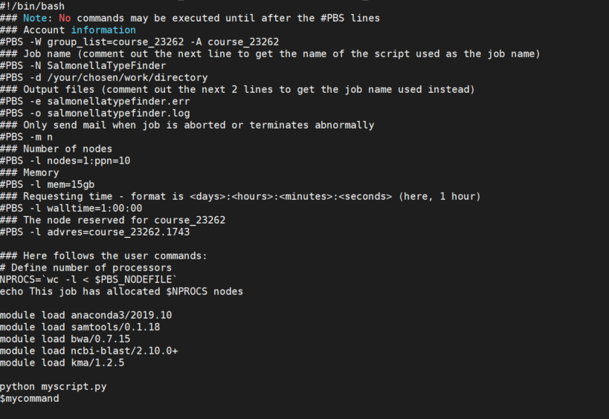

Slide 10
For further help
Computerome 2.0 Wiki - Computerome 2.0 Wiki - Computerome

